Slide 1
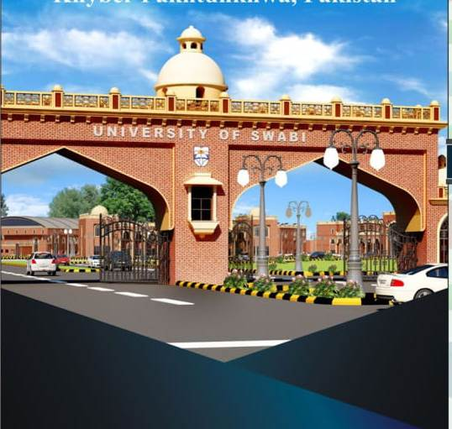
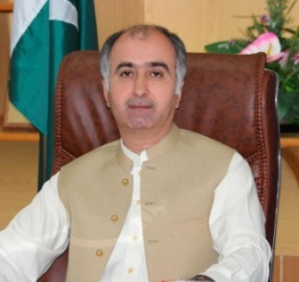
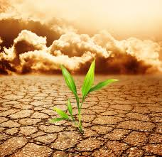
1st International Conference on
Climate Change Impacts on Agriculture and Food Supply
CALLS FOR ABSTRACTS
24-26th APRIL 2018,
University of Swabi,
KP Pakistan
Climate is one of the dynamic forces in the natural history of the earth and thus its continuous changes is affecting certain places conducive to species flourishing, and in some cases, disappear. Changing Climate is likely to affect not only the food web and its supply at the global, regional, and local level but also it can disrupt food availability, access to food and its quality. Projected increases in temperatures, changes in precipitation patterns, changes in extreme weather events, and reductions in water availability may all result in reduced agricultural productivity. Increases in the frequency and severity extreme weather events can also interrupt food delivery, and resulting spikes in food prices after extreme events are expected to be more frequent in the future. Increasing temperatures can contribute to spoilage and contamination. The impacts of climate change have been observed to imbalance the current approaches to food security. The effects of global climate change on agriculture sector and its different levels of response are still insufficiently well developed. Mitigation and adaptation strategies are crucial key challenges to respond to climate change for future research both in theoretical and applied realms. With these spotlights, we invite the scholars, researchers, academicians, practitioners, entrepreneurs, industrialists and policy makers to share their ideas and research on this platform.
Patron in chief
Dr. Imtiaz Ali Khan
Vice Chancellor,
University of Swabi
Important Dates
Abstract Submission Oral/Poster
4th April 2018
Acceptance/Rejection
9th April 2018
Registration Deadline
16th April 2018
Conference registration Fee
International Participants USD 100
Staff/ officers Registration fee PKR 1500
Student Registration fee PKR 1000
CONFERENCE TRACKS
In this conference, potential topics include, but are not limited to:
Vegetation effects on weather and climate and land use
Effects of climate change on plant biodiversity
Direct and indirect climate change impacts on global vegetation change
Effect of environment on plant growth
Plant–plant interactions and environmental change
Direct and indirect impacts of climate change
Recent and future climate change and their implications for plant growth
Significance of temperature in plant life
Water availability and productivity
Modeling and its role in responses to climate change
Impact of climate change on live stocks, fisheries.
For further information please
Prof. Dr. Mukhtar Alam (Patron)
Dr. Hidyat Ullah (Conference advisor)
Dr. Shah Fahad (Focal Person)
Dr. Fazli Wahid (Coordinator)
Email: agriculture@uoswabi.edu.pk
Cell no: 03009304952
Registration form is available at:
http://uoswabi.edu.pk
International Invited Speakers:
USA, China, Turkey, Egypt

